Slide 1
Network Design Proposal for 3 - Star Hotel

Slide 2
Submitted By:
Shubhankar Garg
RA1811003010262
Arpit Manocha
RA1811003010264
Rishabh Prakash
RA1811003010272
Atul Kumar Amresh
RA1811003010276

Slide 3
All the rooms should have computers installed.
The computers in all the rooms should have internet connection.
The guests in the rooms should have free internet access.
The computers should have appropriate security software’s installed.
There are 15 users on the hotel management who requires computers.
The hotel management staff and the guests should be on different networks.
A hotel management server needs to be setup for the hotel management staff which should not be accessible by the guests.
The swimming pool area and lobby should have wireless internet access.
The wireless access in the lobby and swimming pool area should be secure.
Project Objectives

Slide 4
Contents
03
02
01
Requirement Analysis
Network Design Strategy
Hotel
Infrastructure
06
04
05
Network
Diagram
Network
Setup
Recommended Products

Slide 5
Hotel Infrastructure
The hotel has 15 floors with 10 rooms in each floor
01
The hotel has a lobby area.
02
The hotel has a swimming pool area.
03
ADSL Internet is available for the hotel.
04

Slide 6
Hotel Room
The strategy is to create a network that has highest quality and standards.
We can connect all the 10 computers on a floor directly with the router but its cost estimation is higher as compared to a switch.
We can also connect the PCs with a hub but it is inefficient because its speed of data transmitting is very unequal to a switch.
So, we’ll use switch to connect the PCs using Fast Ethernet cables with the switch which will be further be connected to Primary Router.
For maintaining the privacy of the users we’ll ensure that one room’s PC shouldn’t be able to connect to another room’s PC and appropriate security software’s will be installed.
We’ll implement Ethernet connection to provide internet for the guest so as to avoid complexity of Wi-Fi login id and password.
We’ll use primary router in order to provide guests with a different network than the hotel staff.
Network Design Strategy

Slide 7
Network Design Strategy Contd…
Hotel Management
ADSL
Lobby & Swimming Pool
We have a total of 15 staff in the management department so we require a network design for them too.
All the Staff PCs are to be connected to the Staff Router with the help of a switch as we have done with the Hotel Room PCs.
We’ll provide the hotel management with Staff Router which will provide different network for the Staff and will not be accessible by guests.
Asymmetric digital subscriber line (ADSL) is a type of DSL broadband communications technology used for connecting to the Internet.
ADSL allows more data to be sent over existing copper telephone lines when compared to traditional modem lines.
We are provided with an ADSL connection which is already in use with the hotel.
The hotel has a Lobby and Swimming Pool area for its guests so that they can enjoy and relax.
To provide internet connection in both the areas we’ll be setting up Wi-Fi facility.
Both of the Wi-Fi will be password protected so that other than the guests no one could access it.

Slide 8


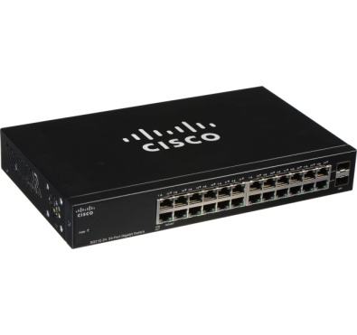
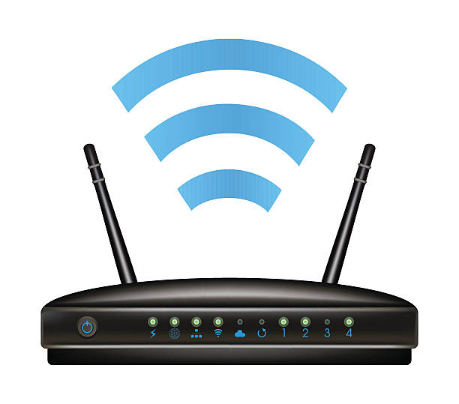
Requirement Analysis
PC
Switch
Router
Wi-Fi Repeater
The 3 - star hotel support 10 computers in each floor.
The hotel has 15 staffs in the hotel management. So, 15 PCs would be required.
So, total 165 PCs would be required.
All the 10 PCs of the floor are connected to one switch.
We will need 1 switch to connect all 15 – PCs of hotel management and 1 for connecting Wi - Fi with ADSL.
So, total 17 switches would be required.
As per our requirement we’ll require 2 Routers:
Primary Router
Staff Router
Primary Router will be connected to the Room PCs.
Staff Router will be connected to the Staff PCs.
To provide wireless internet access in the lobby and the swimming pool areas we’ll require 2 Wi-Fi Repeaters.
Wi-Fi repeaters are easier to set up and configure
Ethernet Cables

Slide 9
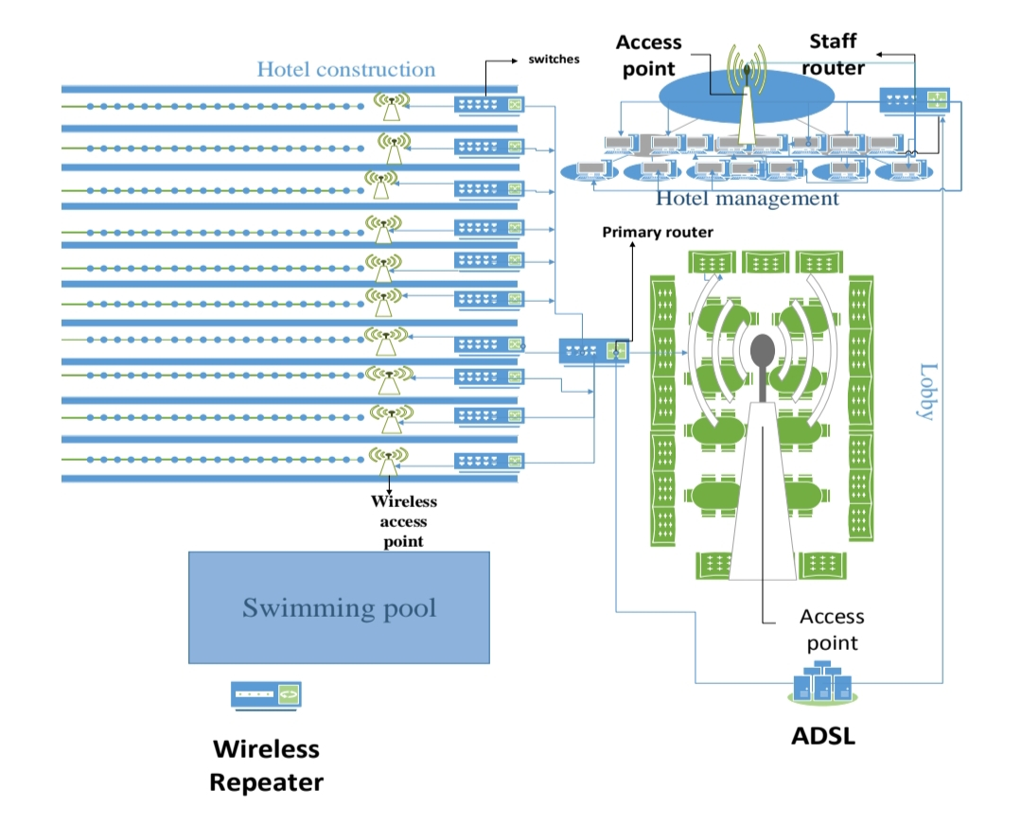
Network Diagram
Primary Router
Staff Router
The primary router has wired connection by access point to all the guests in the lobby. Also primary router links the ten floor switches as LAN.
Staff router provide wired internet connection to the Staff PCs of Hotel Management.
Wireless Repeater
ADSL
In swimming pool there is a wireless repeater which repeats access point of primary router signal.
ADSL provide an internet connection to hotel management’s staff router, primary router and Wi – Fi repeaters.

Slide 10
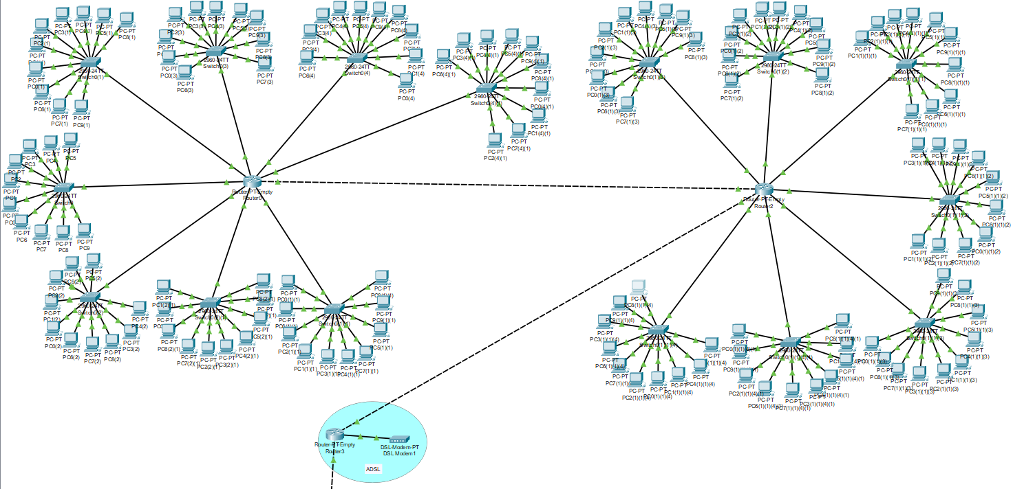
Network Setup
To demonstrate our project design and idea we have used Cisco Packet Tracer Software.
As discussed we connected the 10 PCs of one floor with one switch and same applies for rest of the floors.
The Switches representing each floor are then connected to the Router, which is further connected to the ADSL
We have used two routers in our Cisco Model as Cisco Routers (PT – Empty) provide a maximum of 10 port.
Network Design For Hotel Rooms

Slide 11
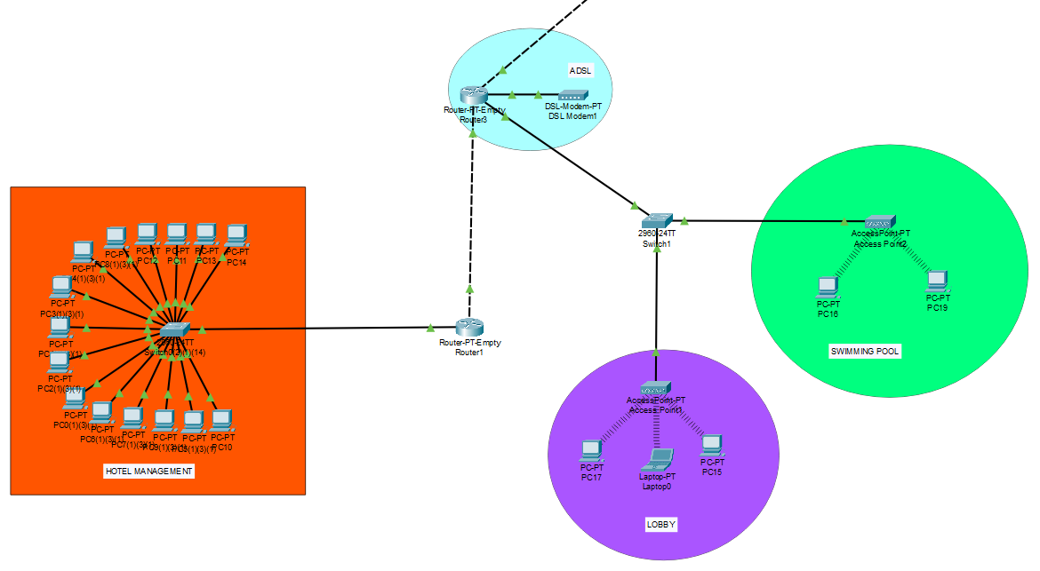
Network Setup Contd…
We have again used PT - Empty Router for the Staff Router and for connecting the lobby and swimming pool Wi- Fi to the ADSL we have used a Switch.
For the ADSL design we have used a Router which is connected to DSL Modem which is under the category of WAN Emulation in the Networking Devices.
To demonstrate wireless internet access in the lobby and swimming pool area we have used Wireless Device AP – PT under the Networking Devices category of Cisco Packet Tracer.
The Wireless connection is password protected.
Network Design For Hotel Management, Lobby and Swimming Pool Area
Wi - Fi
Wi - Fi

Slide 12
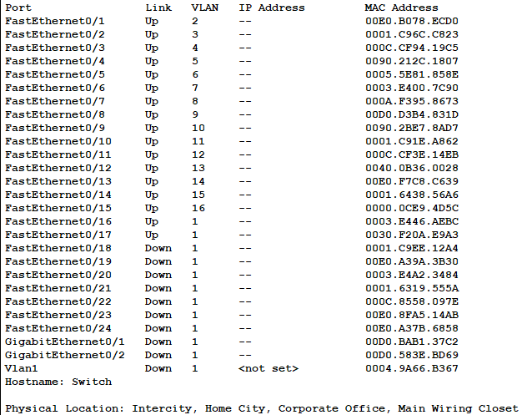
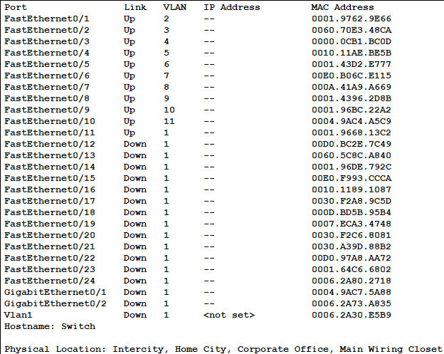
Network Setup Contd…
Configuring VLAN for Floor PCs
Configuring VLAN for Staff PCs
A VLAN (virtual LAN) is a subnetwork which can group together collections of devices on separate physical local area networks (LANs).
To avoid one guest from accessing another guest’s PC or the Staff PC’s we have assigned each PC with different VLAN. Same applies for Staff PCs too.
Advantage of VLAN is that it can allow different PCs having same VLAN value to connect to each other. So we can have different groups of PC that can have intra connectivity but not inter.
For example we can group all PCs of accounts department under one VLAN so that only accounts staff can access each other. Others won’t be able to access Account Department’s PC.

Slide 13
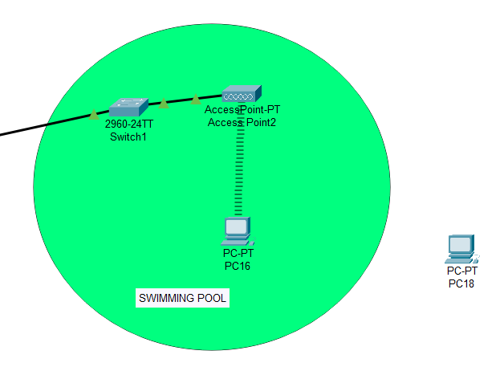
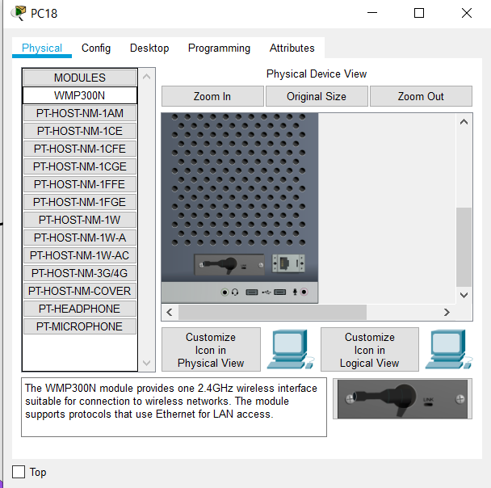
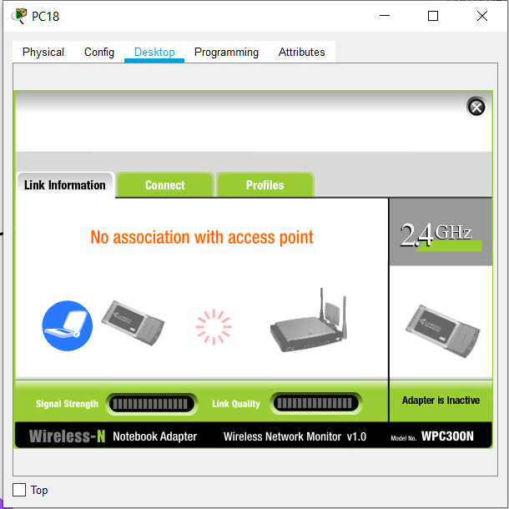
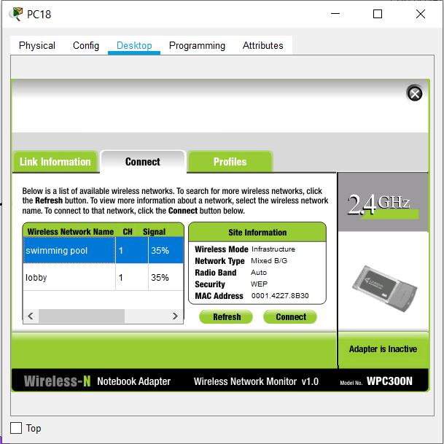
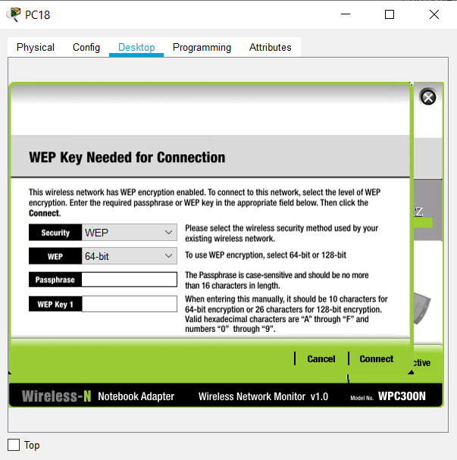
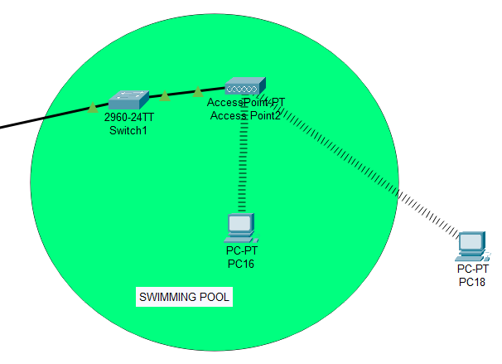
Network Setup Contd…
We have setup Wi - Fi for the lobby and swimming pool area with password protection.
Here, we are testing the Wi - Fi by bringing in a new PC and connecting it with the Wi - Fi.
As we can see in the 4th image that both of the Wi - Fi are discoverable which shows that both of them are functioning properly.
When the user selects the required Wi - Fi and taps connect, he/she is asked to provide password for the Wi - Fi in the 5th image.
On providing the correct password the PC get connected which we can see in the last image.
Setting up Wi - Fi

Slide 14
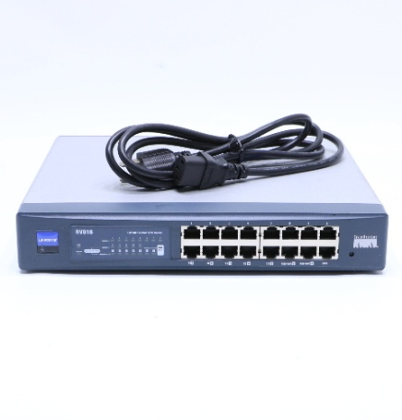
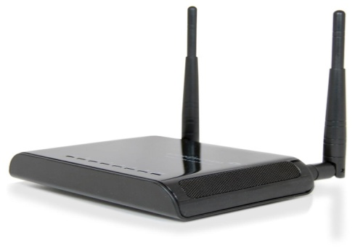
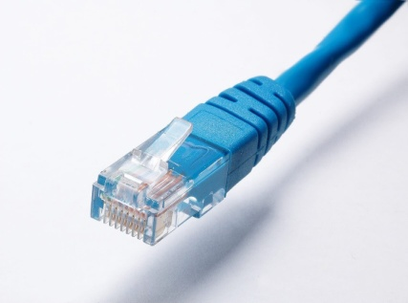
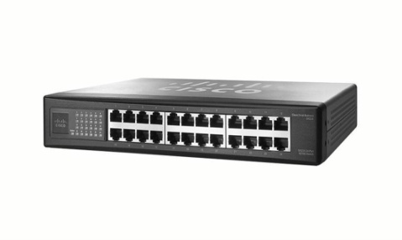
Recommended Products
 | Your Text
 | x2
 | x17
 | x2
 | As per Hotel’s Dimension
CISCO LINKSYS RV016
16 - PORT 10/100 ROUTER
CISCO SF - 100 SR224T
24 – PORT 10/100 SWITCH
AMPED WIRELESS SR - 300
High Power Smart Repeater
MEDIABRIDGE FBA 31-299-100B
Highly Durable Ethernet Cable

Slide 15
THANK YOU

